Slide 1
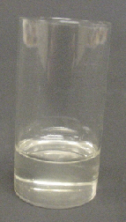
Melting observations
Candles are made from wax.
Heating pure wax can make it melt.
heating

Slide 2
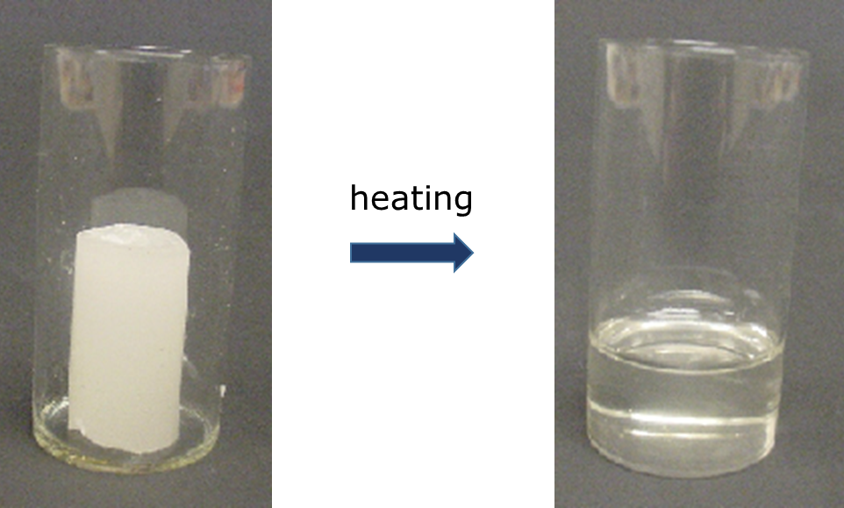
Melting observations
The melting point of pure wax is 67ºC.
1. At what temperature does the wax start to melt?
A
Around 60°C
B
65°C
C
67°C
D
69°C

Slide 3
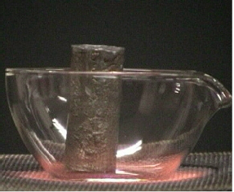
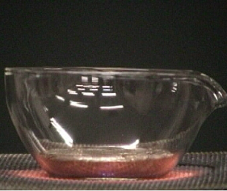
Melting observations
Lead is a type of metal.
Heating lead can make it melt.
heating

Slide 4
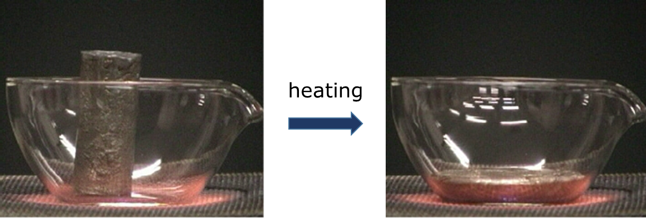
Melting observations
Lead starts to melt at 327ºC.
2. What is the temperature of lead when the last bit melts?
A
327°C
B
328°C
C
329°C
D
Around 332°C

